Slide 1
Predicting Length of Stay using MediCare claims data
Anay Dutta
Zohaib Sheikh
Pruthvinath

Slide 2
Overview
Data: 4 different datasets:
Beneficiary summary (2008 - 2010)
Inpatient Claims
Outpatient claims
Beneficiary summary Sample:
Contains 32 variables across all the 3 years
Approx. 115k records each year
Inpatient claims Sample:
Contains 81 variables
Approx. 66k records
Outpatient claims sample:
Contains 76 variables
Approx. 790k records

Slide 3
Project objective:
Predicting Length of stay based on Beneficiary summary and Inpatients and Outpatients claims data

Slide 4
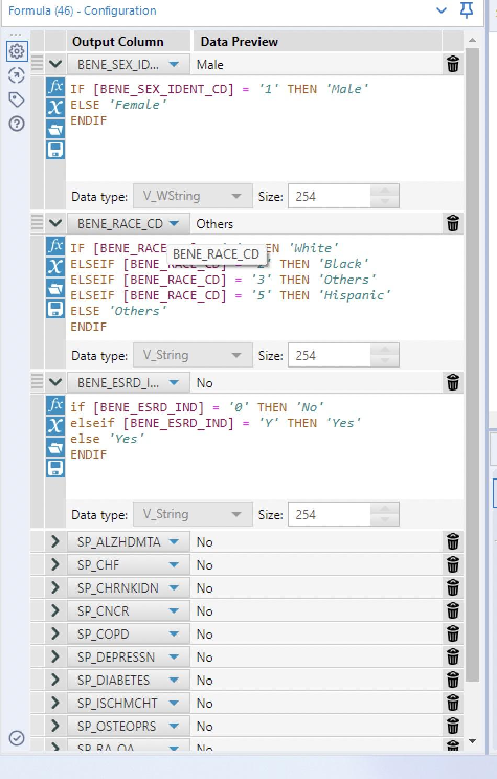
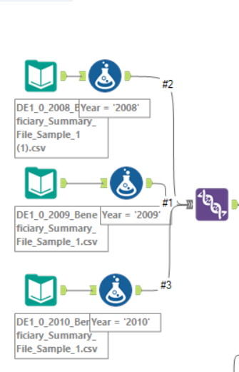
Feature Engineering - Beneficiary Summary Data
Appending 3 years data sets of Beneficiary summary (2008 - 2010)
Creating a column to denote year
Converting the data type of required features.
Converting different columns from having numerical values to categories for classification (this also helps in not misunderstanding the numerical categories as numerics in modelling)

Slide 5
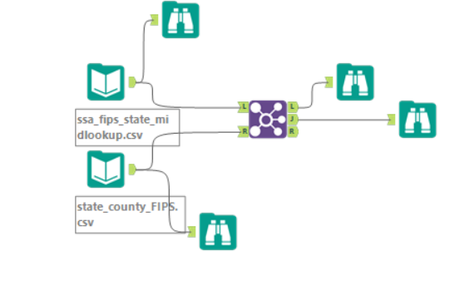
Combined different coverage months of part A, B, D into new single column i.e. Bene_Covered into 2 categories: Yes or No => >99% beneficiaries are covered => no much variance => not included in the final model.
Tried to utilize the State and County SSA codes to extract the relevant population information the beneficiary is exposed to.
No common columns to join hence unable to extract population information.
Then removed the above raw columns.

Slide 6
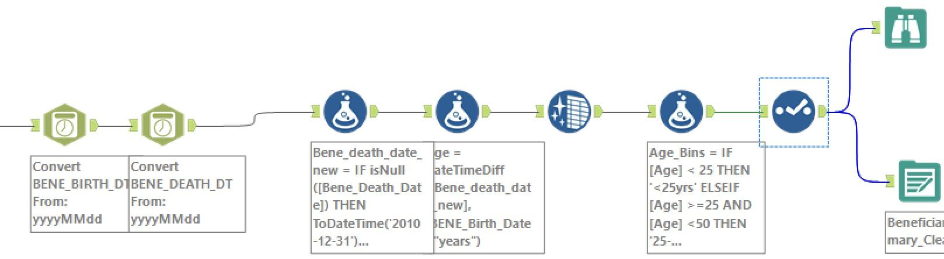
Manipulating the birth and death dates (or with 2010-12-31) to find the Age and then converting age into age categories as <25 years, 25-50 years, 50-75 years and >75 years.
Then removing null values in entire data set and also the reimbursement amounts columns as those amounts comes after the patient discharge => no role in estimating length of the stay.
Atlast, output the beneficiary summary data set into a CSV file, which then be used in tests and modelling.

Slide 7
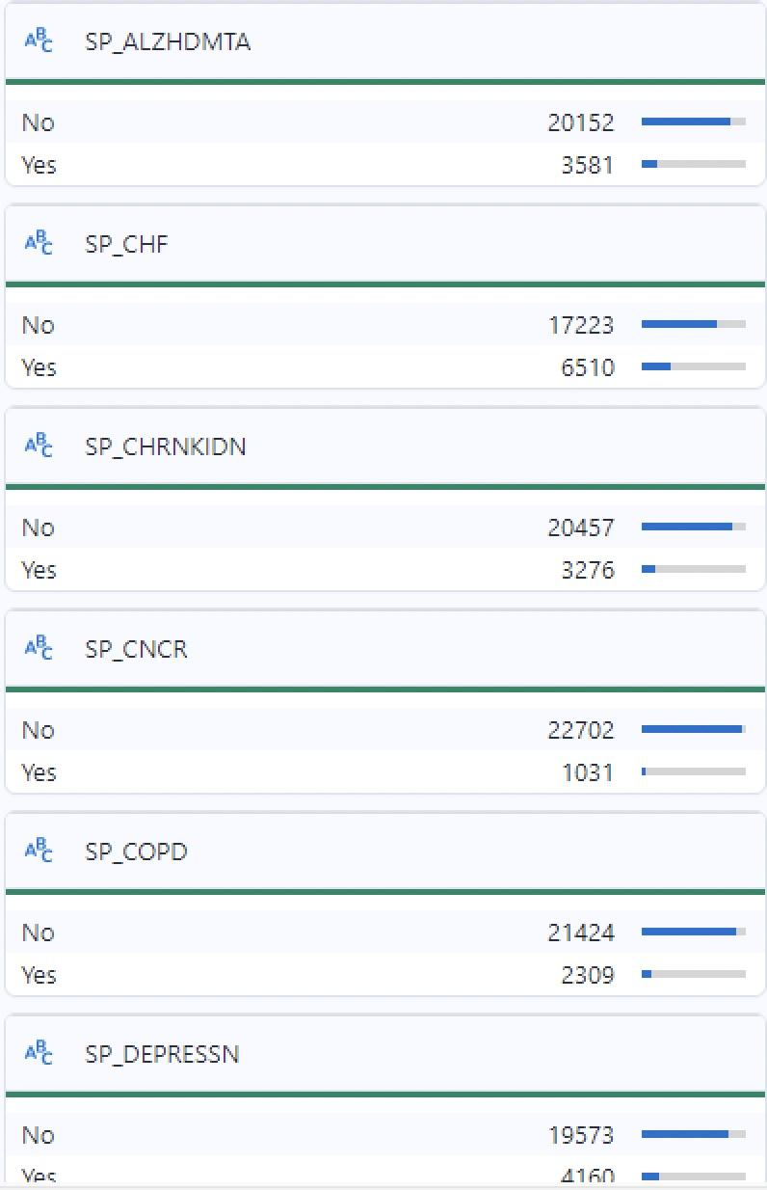
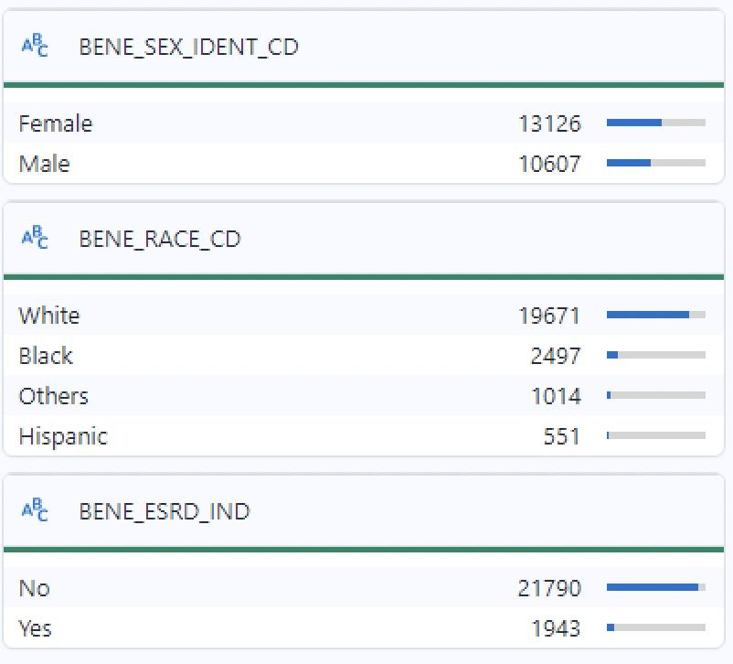

Slide 8
Feature Engineering- Inpatient Dataset
Didn’t consider all payment related columns because all the payment related data is collected at the end of discharge.
Didn’t consider all the physician number related columns as those are not related to the length of stay.
Created a new column “Length of stay” using "CLM_FROM_DT", "CLM_THRU_DT"
Removed the column “Segment” because of disproportionate values.
Based on codes categorised “ADMTNG_ICD9_DGNS_CD” into 9 categories: 'Circulatory',"Respiratory" , "Digestive", "Diabetes" , "Injury", "Musculoskeletal", "Genitourinary", "Neoplasms", "Supplementary factors"

Slide 9
Feature Engineering- Inpatient Dataset
Engineered a New column “Number_of_Visits” - Based on date-time the values were calculated giving us the information on the number of times the patient revisited.
Constructed two new columns “Year” column and “Inpatient vs Outpatient”
Based on ICD9_DGNS_CD_1-9 columns constructed a new column “Count_DGNS”- which gives us the count of preliminary diagnoses.
Data Leakage - columns related to ICD9_PRCDR_CD were removed taking data leakage into account.
Length of Stay was categorised in to: “Short (0-9)” , “Long (10-15)” , “Over-Long (>15 days)”
Columns taken in to account:
DESYNPUF_ID, ADMTNG_ICD9_DGNS_CD, num_vists, Length_of_stay, Year, Inpatient_Outpatient, Count_DGNS

Slide 10
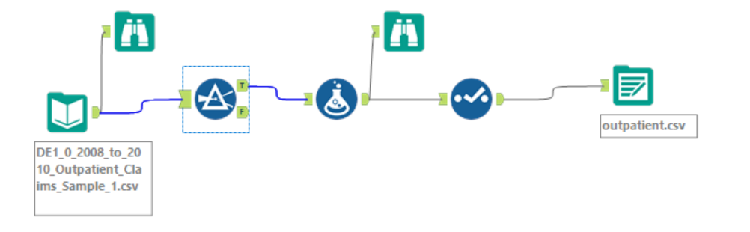
Feature Engineering- Outpatient Dataset
Similar Column transformations were applied on Outpatient Dataset as were applied on Inpatient Dataset
Only those rows were considered where Length of Stay was greater than 0.
(Total records in this dataset = 790,790; Kept records = 94,402
Columns taken in to account:
DESYNPUF_ID, ADMTNG_ICD9_DGNS_CD, num_vists, Length_of_stay, Year, Inpatient_Outpatient, Count_DGNS

Slide 11
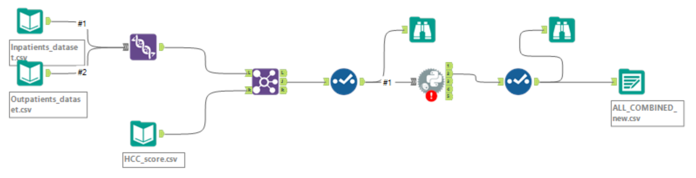
Combining Inpatient, Outpatient Dataset with HCC score Dataset
The Inpatient Dataset was concatenated with Outpatient Dataset.
HCC Score Dataset was inner joined with with the Combined dataset of Inpatient & Outpatient;
We got a new column “HCC_score”

Slide 12
All Combined and removing duplicates
Finally the Beneficiary Dataset was combined with everything else on two columns “DESYNPUF_ID” and “Year”.
Joining with “Year” column was really important here in order to capture the details of the patient for that particular year.
Duplicate rows were removed.
One-Hot-Encoding was performed on the categorical columns.
Final Output saved saved in a .csv file which will be used for model Building

Slide 13
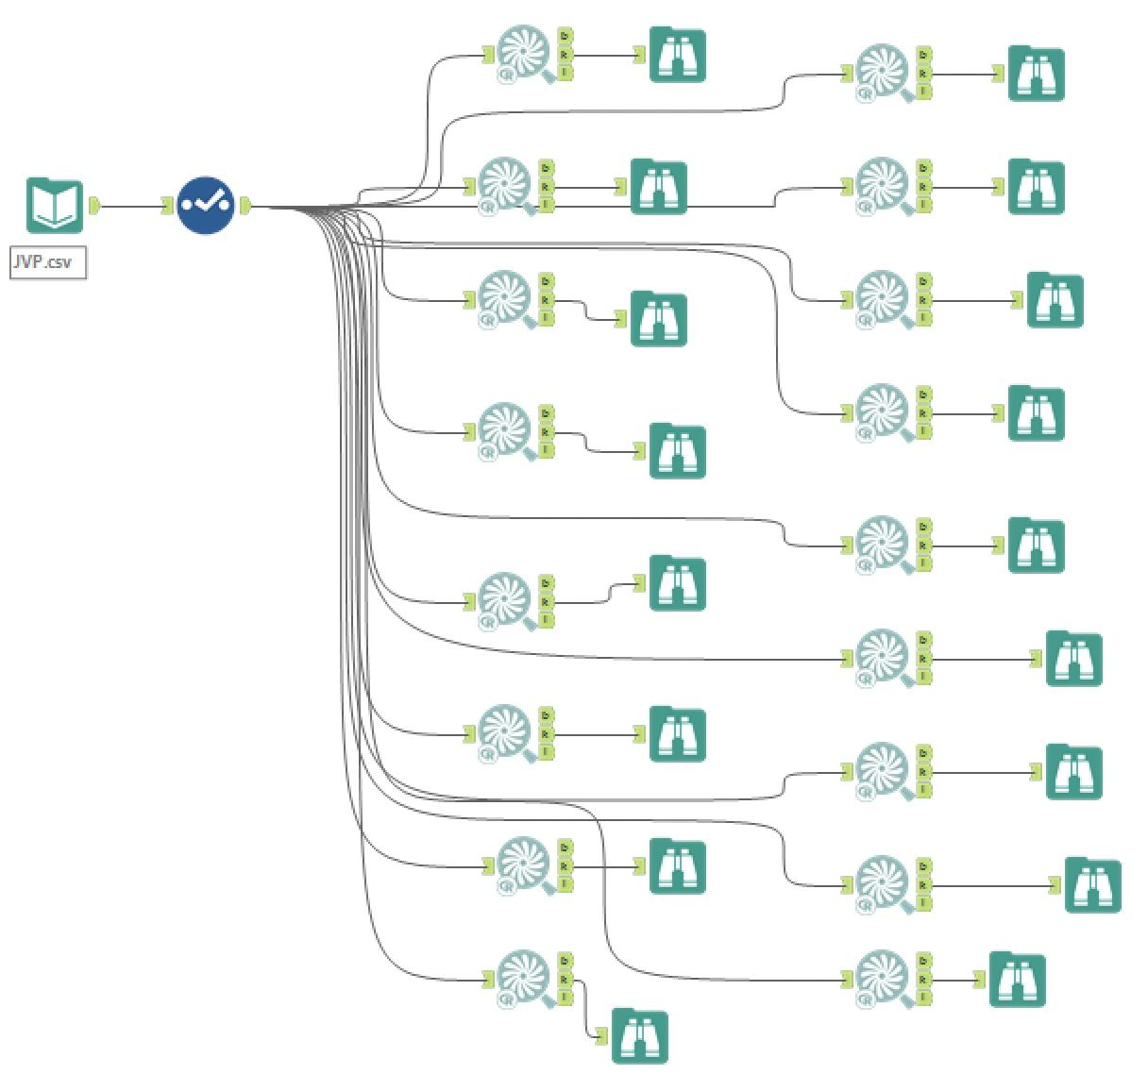
Tests
Performed chi-square tests on different categorical variables with Length_of_stay (categorical).
Categorical columns which are significant (p < 0.05):
Age_bins
ESRD
All past disease conditions except ISCHMCHT and Osteoporosis.
Numerical columns which are significant are:
HCC scores
Number of visits
Total diagnosis codes

Slide 14
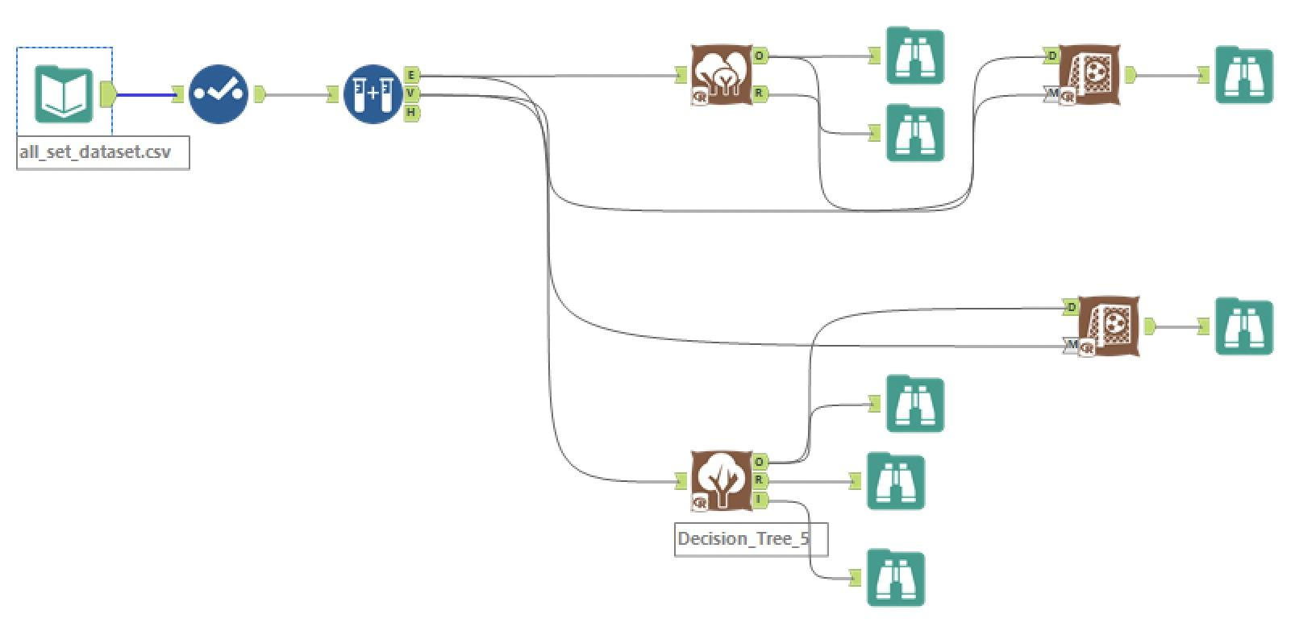
Model Building
Input the one hot encoded CSV file with all the required columns.
Created sample split between training and validation data sets (75:25)
Ran the forest and decision tree models.

Slide 15
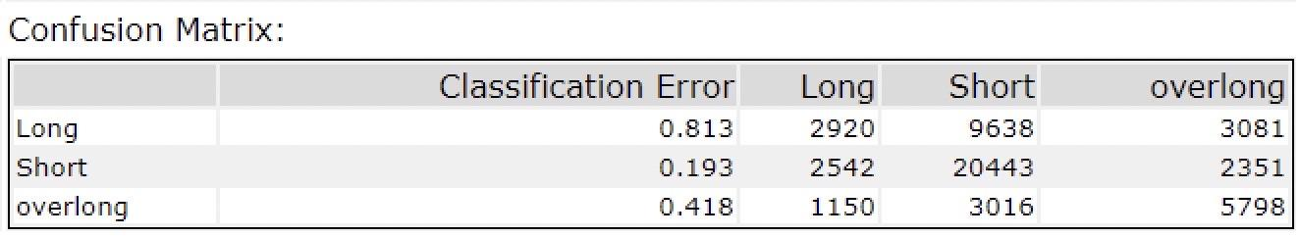
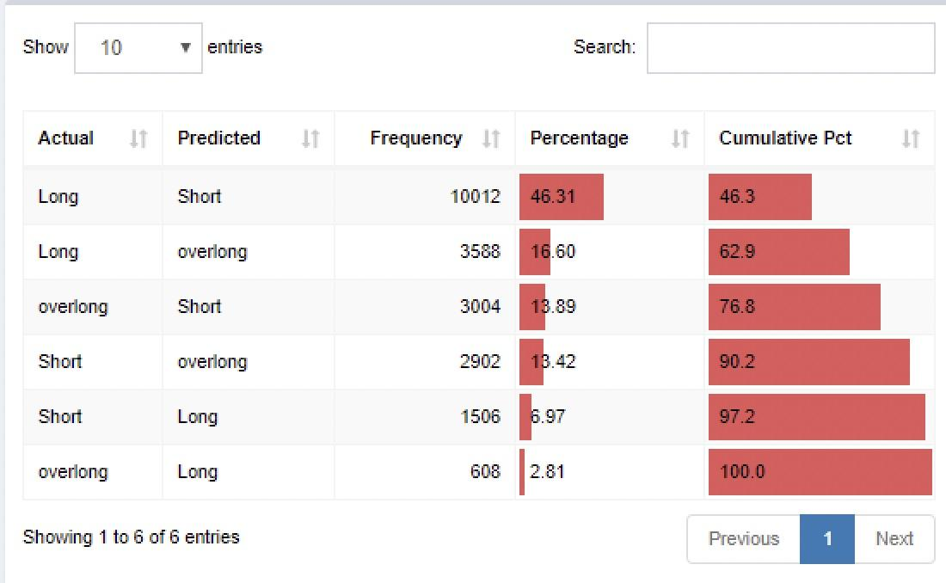
Results
The confusion matrix shows that the model is more biased towards estimating ‘Short’. It can be observed more in estimation of ‘Long’ stay. The model needs further improvement regarding the classification of length of stay.
Predicting ‘Long’ as ‘Short’ more. So need to increase the number of days of stay as ‘Long’ => so that present lower range of ‘Long’ category comes to ‘Short’ category.
Same for the rest.

Slide 16
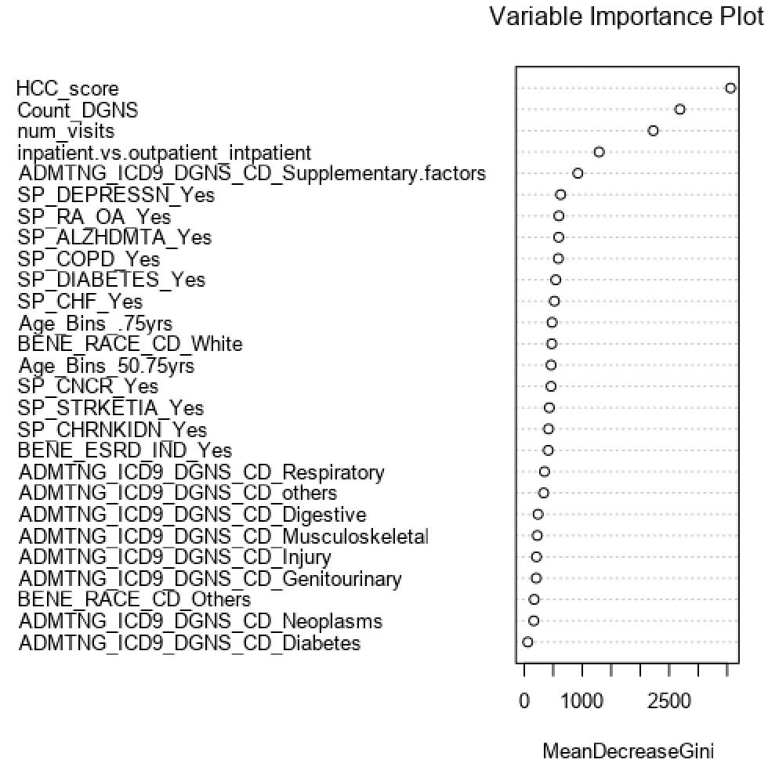
From variable importance plot:
The important variables are numerical columns i.e. HCC Score, Num of Diagnosis codes, Num of visits than categorical variables.

Slide 17
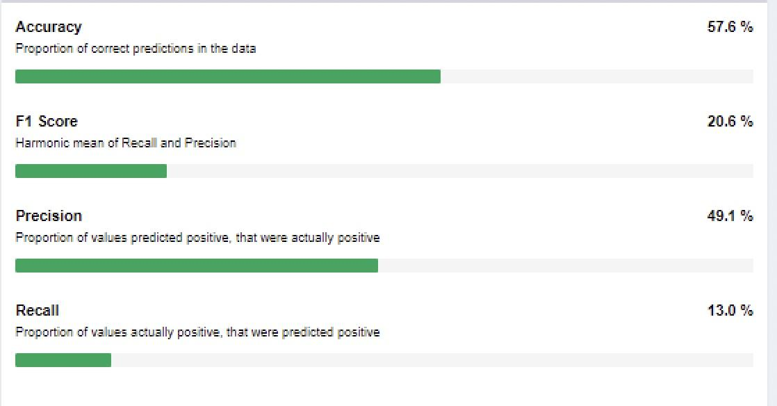

Slide 18
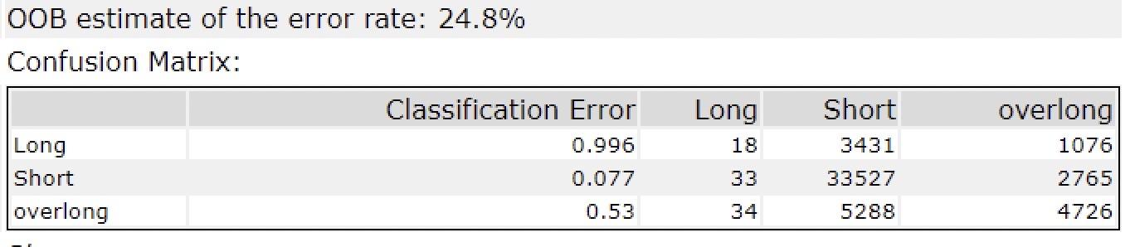
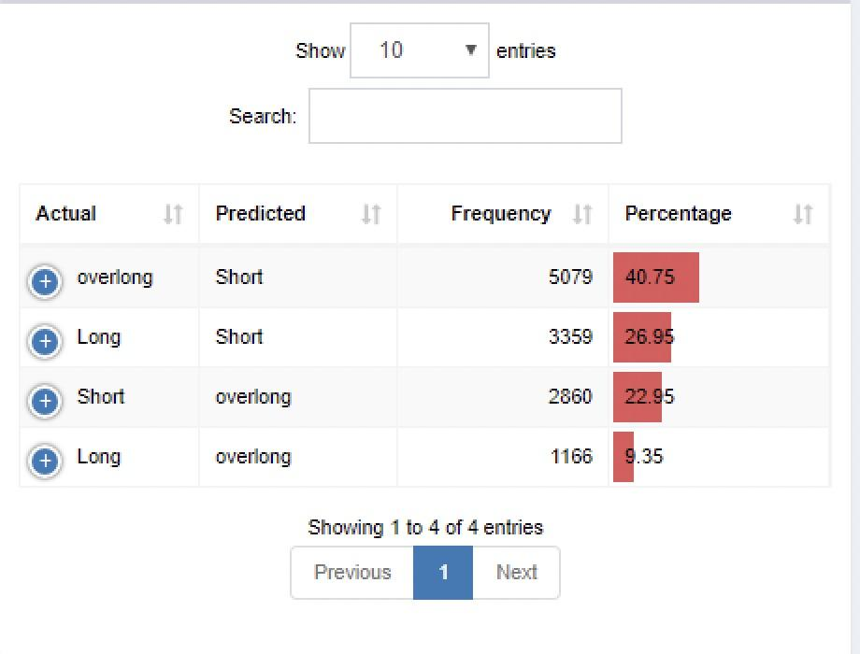
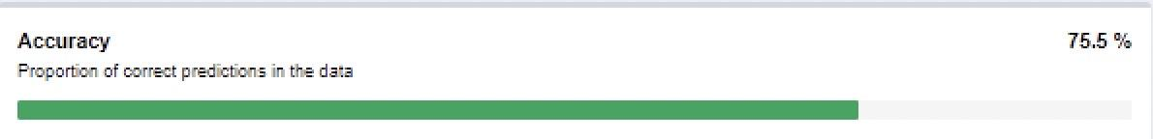
After recategorizing the length of stay column into different ranges, the results as follows:
Now the errors are reduced.

Slide 19
THANK YOU!!

